Slide 1
Chapter 12

Slide 2
Objectives

Slide 3
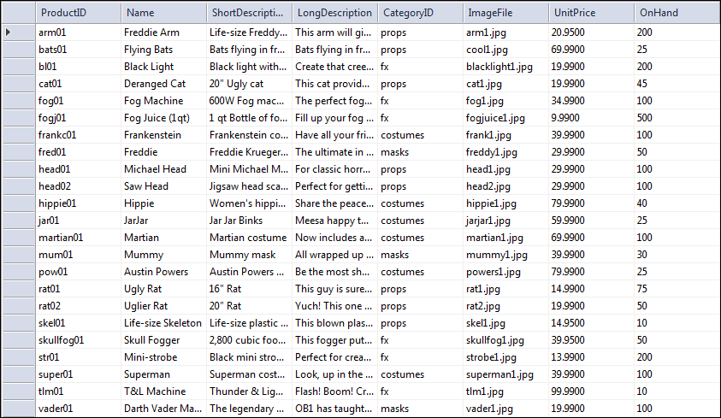
The Products table in a Halloween database
Primary key
Columns
Rows

Slide 4
Concepts

Slide 5
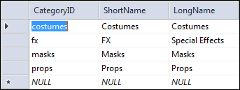
The relationship between two tables
Primary key
Foreign key

Slide 6
Relationship concepts

Slide 7
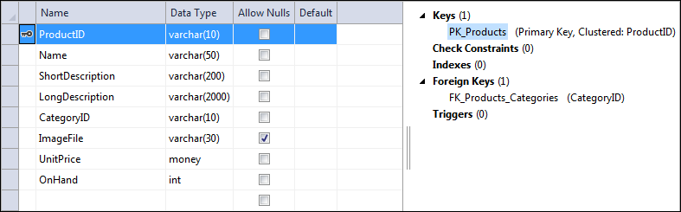
The design view window for the Products table

Slide 8
Common SQL Server data types

Slide 9
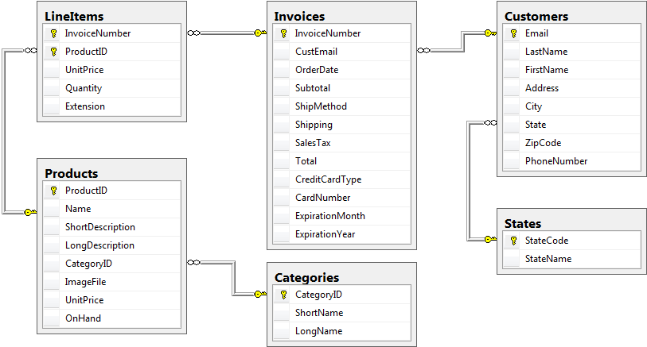
The tables that make up the Halloween database

Slide 10
Simplified syntax of the SELECT statement

Slide 11
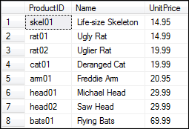
A SELECT statement that retrieves and sorts selected columns and rows
The result set defined by the SELECT statement

Slide 12
The syntax of the SELECT statement for joining two tables

Slide 13
A SELECT statement that joins data from two tables

Slide 14
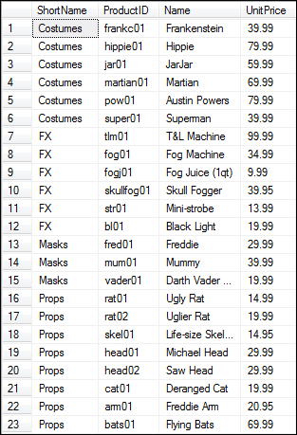
The result set defined by the SELECT statement

Slide 15
The syntax of the INSERT statement for adding a single row
A statement that adds a single row to a table

Slide 16
The syntax of the UPDATE statement
A statement that changes the value of one column for a selected row

Slide 17
The syntax of the DELETE statement
A statement that deletes a specified category

Slide 18
A statement that creates a view named CustomersMin

Slide 19
A SELECT statement that uses the view

Slide 20
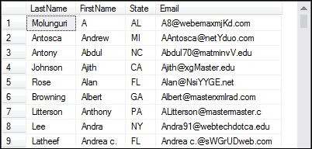
The virtual table that’s created from the view

Slide 21
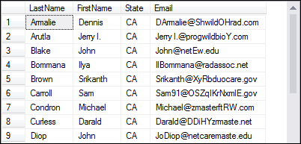
The result set that’s created from the virtual table

Slide 22

A statement that creates a stored procedure named spCustomersByState
The result set when the stored procedure is executed with the @State variable set to ‘CA’

Slide 23
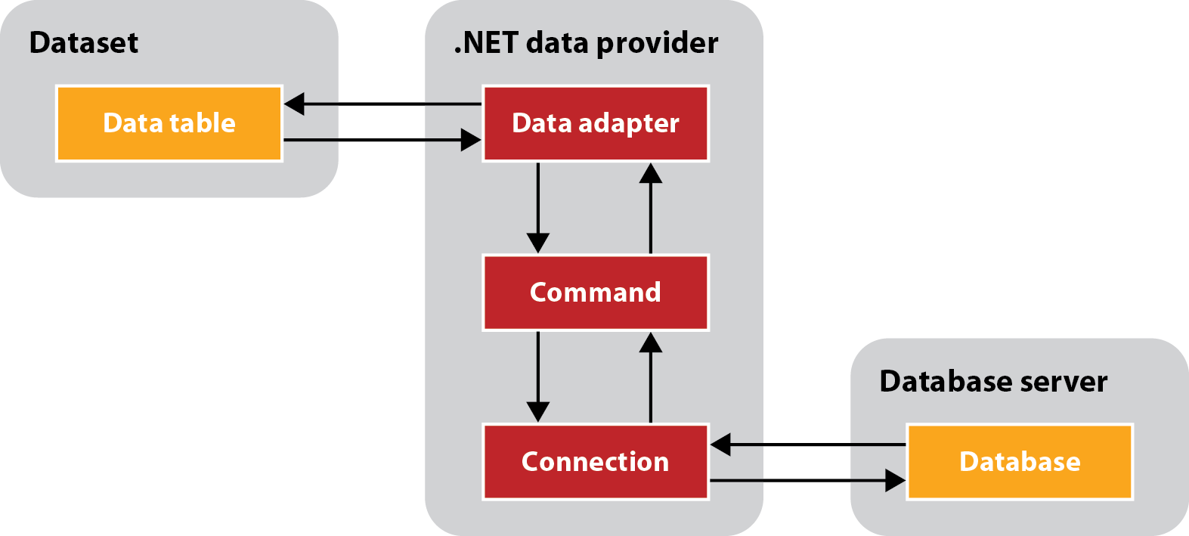
Basic ADO.NET objects

Slide 24
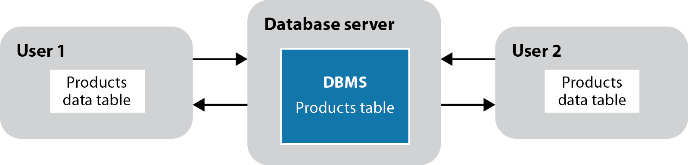
Two users who are working with copies of the same data

Slide 25
What happens when two users try to update the same row

Slide 26
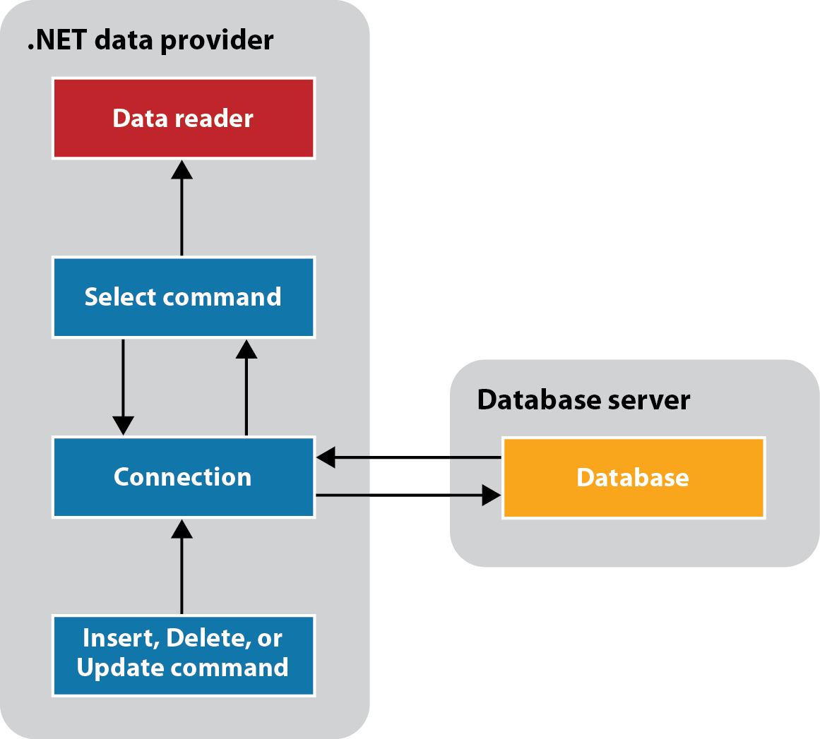
ADO.NET components for accessing a database directly

